Slide 1
Learning Reflection Platform
Presentation 2
Progress Update

Slide 2
Module Details
Core Learning Data :
1. Authentication Module
Handles secure user registration and login
Validates user credentials before granting access
Maintains session-based authentication
Prevents unauthorized access to the system
2. User Profile Module
Stores and manages user personal information
Allows users to view and update profile details
Maintains user settings and preferences
Supports a personalized learning experience
3. Learning Item Management
Allows users to save learning resources via links
Supports editing, deleting, and organizing items
Enables priority tagging for important topics
Allows setting target readiness dates
Module
Purpose: These modules form the core system foundation, managing user identity and storing learning resources in an organized structure.

Slide 3
Learning Intelligence & Automation:
4. Metadata Extraction Module
Automatically extracts title and basic metadata from links
Retrieves H1, H2, H3 headings from supported webpages
Reduces manual data entry
Improves content organization
5. Reminder & Scheduling Module
Allows users to set target readiness deadlines
Generates reminders based on upcoming deadlines
Displays reminders during user login
Encourages timely revision of learning items
6. Interaction Tracking Module
Tracks resource access frequency
Stores last accessed timestamps
Maintains interaction history
Identifies unused or rarely accessed resources
Purpose: These modules introduce automation and learning insights, helping users manage their preparation more efficiently.

Slide 4
Presentation & User Awareness Layer
7. Dashboard & Analytics Module
Provides an overview of saved learning items
Displays learning progress and activity statistics
Shows upcoming readiness deadlines
Helps users monitor learning performance
8. Notification Module
Displays alerts and reminders
Notifies users about pending learning tasks
Appears during user login
Keeps users informed about important updates
Purpose: These modules focus on information visualization and user awareness, enabling users to track progress and stay aligned with learning goals.

Slide 5
Workflow (Team Progress)
The development of the Learning Reflection Platform has progressed through several organized stages as the team planned and prepared the system design.
Initially, the team identified a common problem faced by students: educational resources are often saved for later learning but are rarely revisited or properly organized. Based on this observation, the idea of building a platform that helps users manage and revisit unresolved learning resources was proposed.
After defining the problem and the objective of the project, the team designed the overall system concept and identified the key features required to support structured learning management. These features were then divided into modules, allowing the system to be developed in a modular and organized manner.
The project modules were distributed among the three team members to ensure balanced responsibilities and parallel progress. Each member was assigned specific modules related to different parts of the system, such as user data management, learning intelligence features, and presentation or notification components.

Slide 6
Workflow (Team Progress)
Following the module division, the team selected the technology stack for the system. The frontend interface was planned using HTML, CSS, and JavaScript, while the backend technologies such as Node.js, Express.js, and MongoDB were identified for implementing the system logic and database management.
As part of the current development progress, the team has designed the initial interface prototype of the platform. Several interface pages have been created, including the Add Item page, My Items page, Reminders page, and the Dashboard page, which represent the basic structure of the system.
At this stage, the project has completed the conceptual planning, module division, technology selection, basic interface design, and system modeling. The next phase will involve implementing backend functionalities and integrating the different modules of the platform.

Slide 7
Prepared Frontend (Current Prototype)
Objective
A basic frontend prototype has been developed to demonstrate the platform’s user interface and navigation for managing learning resources.
Technologies Used
HTML5 – Creates the structure of web pages
CSS3 – Designs the layout and visual appearance
Interface Pages Developed
1. Dashboard Page
Displays an overview of the user’s learning activity
Provides a summary of saved learning items and their learning status
Designed to help users quickly understand their learning progress and access important sections of the platform

Slide 8
2. Add Item Page
Allows users to add new learning resources
Provides a form to paste learning links
Collects information related to learning items
3. My Items Page
Displays saved learning resources
Organizes items for easy access and tracking
4. Reminders Page
Displays learning items that need revision
Shows upcoming reminders
Interface Design Features
Simple and clean layout
Easy navigation between pages
Structured organization of learning resources
Designed for future backend integration

Slide 9
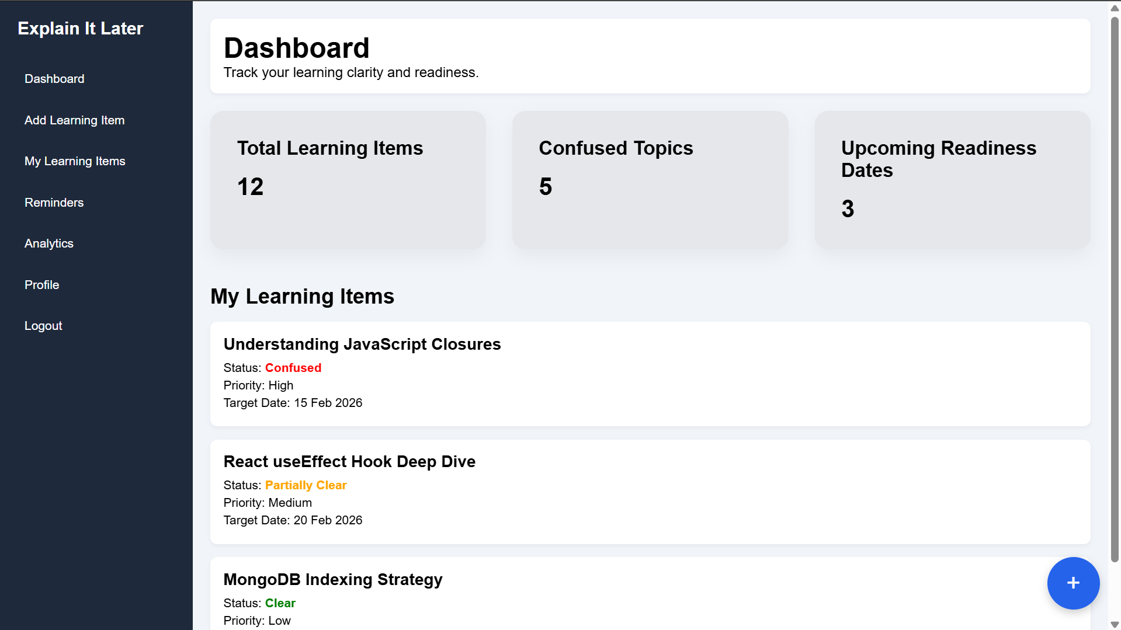
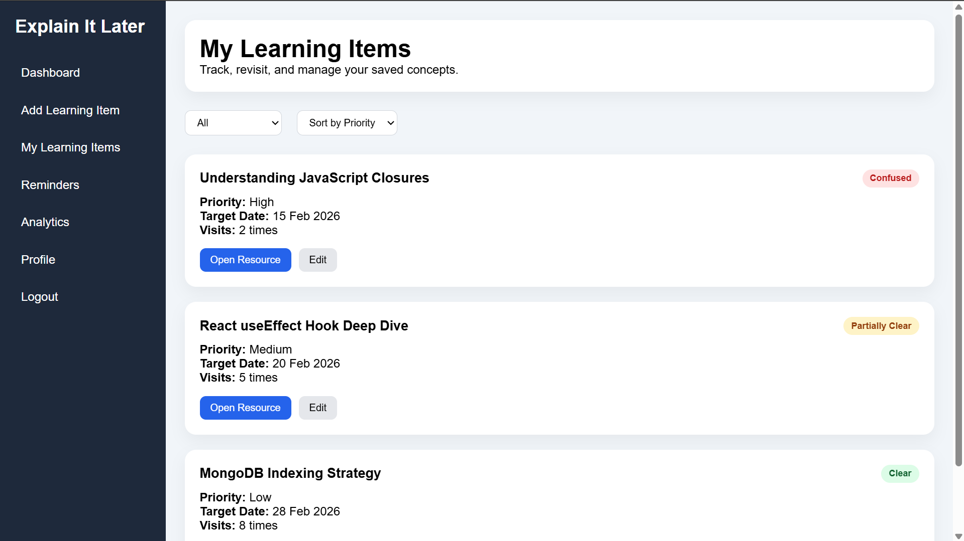
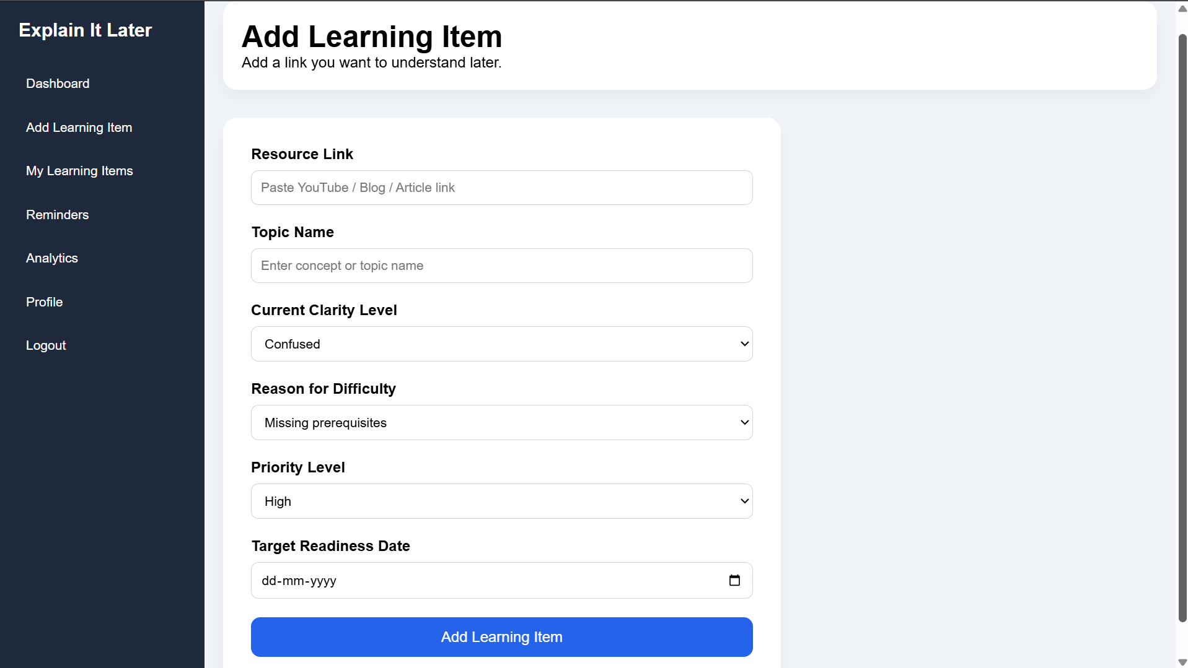
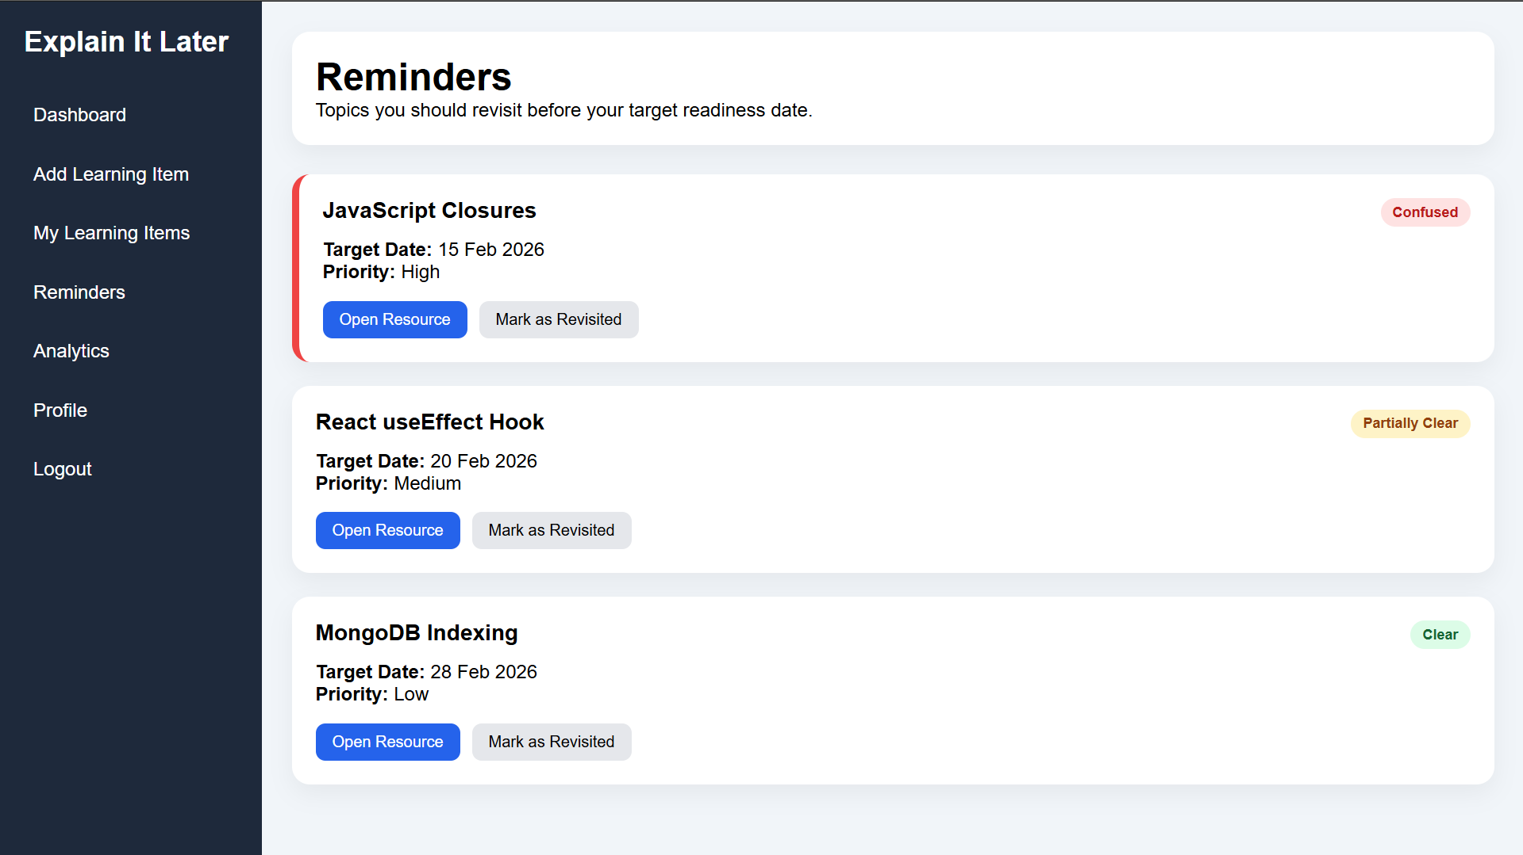

Slide 10


Slide 11
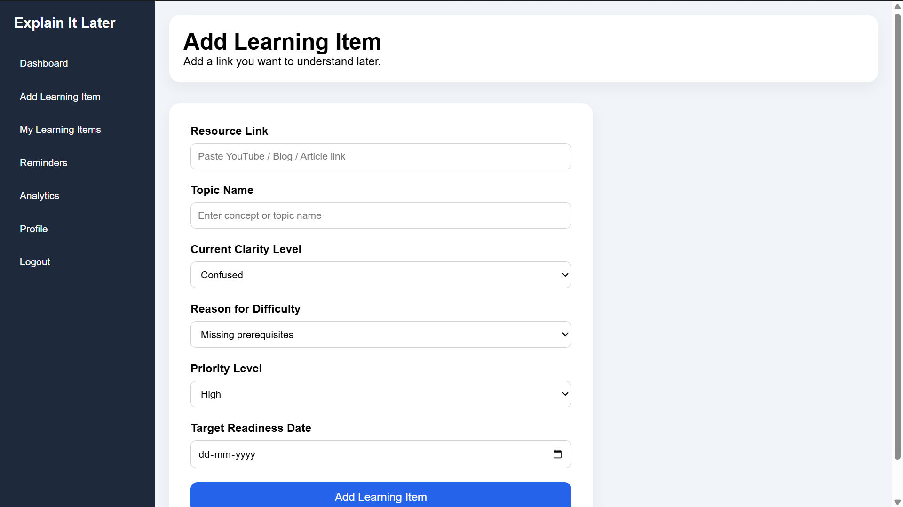

Slide 12


Slide 13
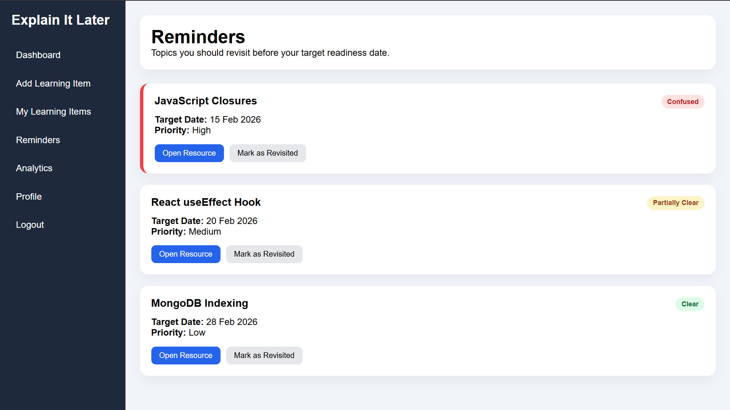

Slide 14
System model
1. User (Actor):
The student/user interacts with the platform through the web interface.
Users can perform actions such as:
Adding learning items
Viewing saved items
Checking reminders
Managing profile details
2. Frontend Layer (User Interface):
Technologies used: HTML and CSS
This layer provides the visual interface through which users interact with the system.
Current pages developed:
Add Item Page – Interface to add learning resource links
My Items Page – Displays saved learning resources
Reminders Page – Shows reminders for learning items

Slide 15
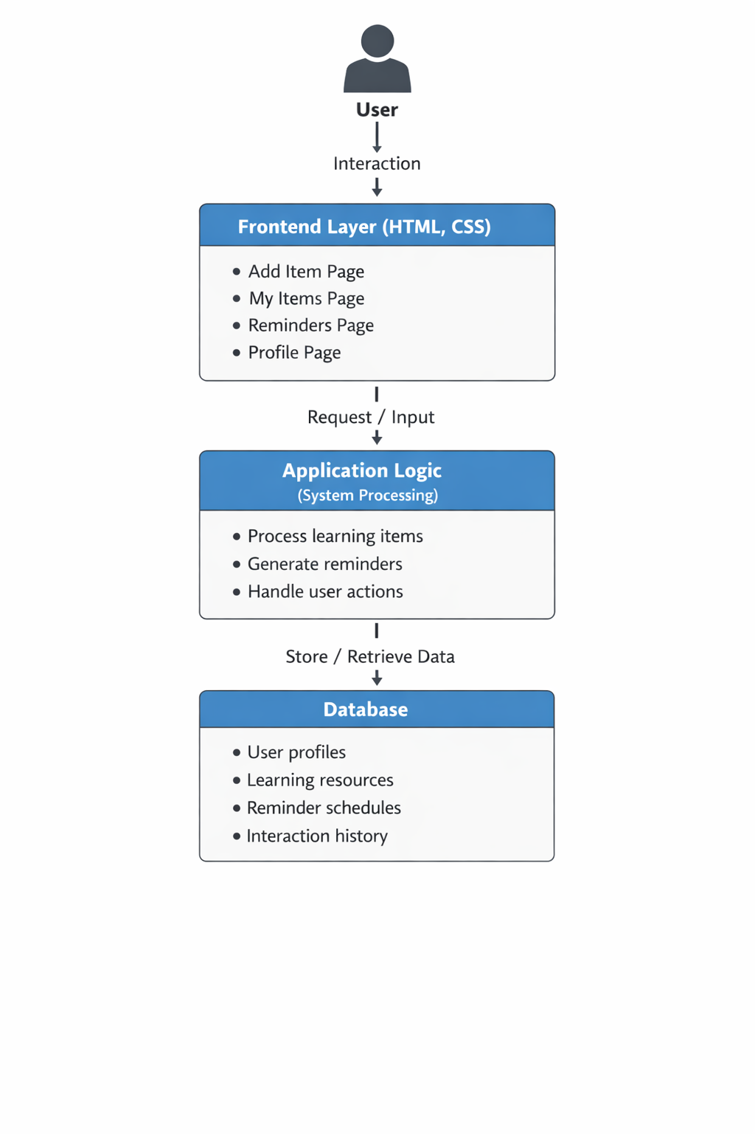
Purpose:
Collect user input
Display stored learning items
Show reminders and notifications
3. Application Layer (System Logic – Future Implementation):
This layer will handle the processing and logic of the system.
Main functions:
Processing learning item submissions
Extracting metadata from links
Tracking user interactions
Managing reminder scheduling
4. Data Storage Layer (Database – Future)
This layer stores all system data.
Data stored includes:
User profile information
Saved learning resources
Reminder schedules
Interaction history
Purpose:
Maintain persistent records of learning items
Support retrieval and analysis of learning data

Slide 16
Use Case Diagram
The Use Case Diagram illustrates how the user interacts with the Learning Reflection Platform and the main services provided by the system.
In this system, the User is the primary actor who interacts with the platform to manage learning resources and track learning progress. The user can create an account and log in to access the system.
Once logged in, the user can add learning items by submitting resource links, which represent concepts or topics they want to understand later. The system can automatically extract metadata from the link, such as the title of the resource.
Users can view their saved learning items, open the learning resources directly from the platform, and manage their learning progress by setting the clarity level, priority level, and readiness date for each item.
The system also supports interaction tracking, where it records when a learning resource is opened. Based on the readiness dates and system conditions, the platform generates reminders and notifications to encourage users to revisit learning items.
Additionally, users can access the dashboard, which provides an overview of their learning activities and saved resources.
The Use Case Diagram helps provide a clear overview of the major interactions between the user and the system.

Slide 17
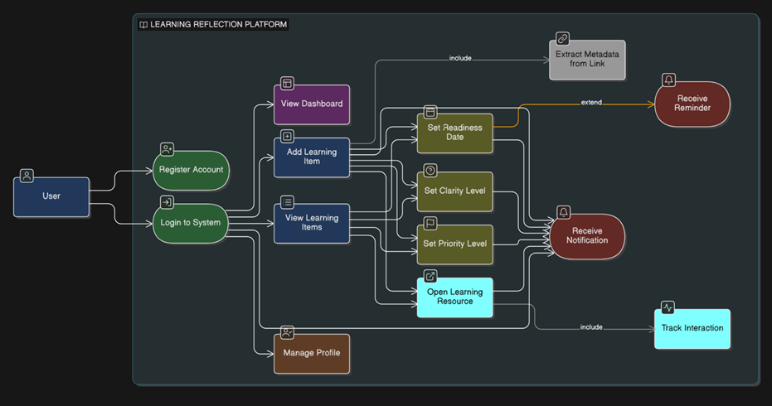
Learning Reflection Platform Use Case Diagram

Slide 18
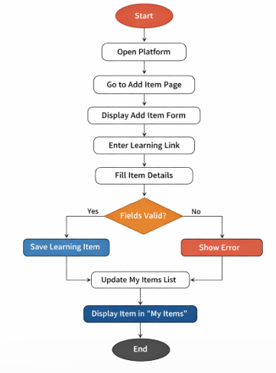
Activity Diagram (for adding learning items) :

Slide 19
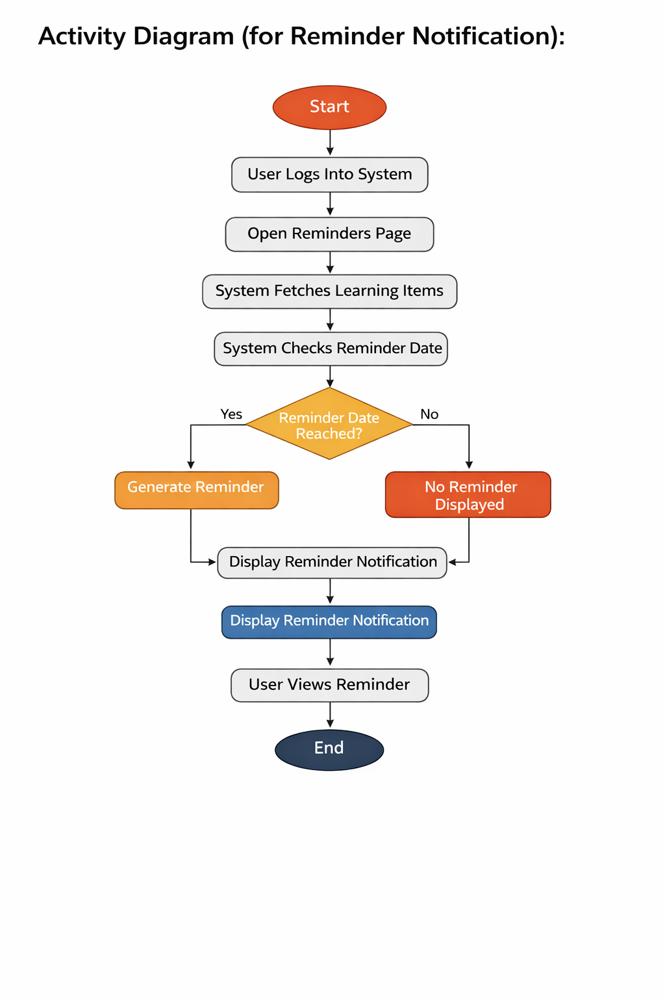
Activity Diagram(for Reminder Notification)

